Slide 1
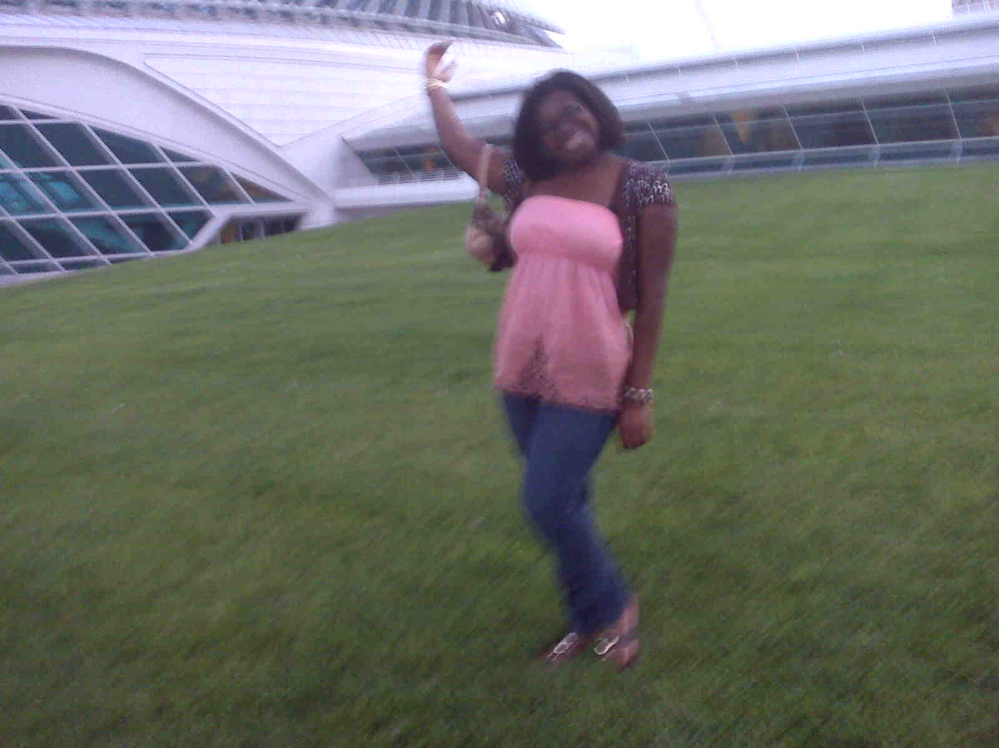
Hi, I’m Shamae from Wisconsin, USA,
the new teaching assistant
at Mädchenrealschule Niedermünster
in Regensburg

Slide 2
Hallo! Ich bin Shamae.
Ich bin in Portland, Jamaika, geboren. Im Jahr 2002 zog ich mit meiner Familie nach Milwaukee, Wisconsin. Ich bin so froh, dass ich in Regensburg sein kann, und ich freue mich auf die Arbeit mit den Schülerinnen.

Slide 3
Milwaukee, Wisconsin
Wisconsin
Wisconsin is located in the Midwest or Great Lakes Region of the USA
The population is 5.7 million people
It is known as the ‘Dairy State’ because there are a lot of farms that produce mainly milk.
Milwaukee
Wisconsin’s largest city
Located on Lake Michigan
It is known as the Brew City because there are big beer industries
We also celebrate Oktoberfest from October 1st-4th

Slide 4
Fun and Play In Brew City
German Fest being celebrated in Milwaukee
Oktoberfest being celebrated in Milwaukee

Slide 5
Great Art & Architecture
The Calling was created by Mark Di Suvero
Santiago Calatrava designed the Milwaukee Art Museum

Slide 6
Milwaukee!
The Milwaukee Art Museum was designed to look like a ship
A view of the Milwaukee skyline

Slide 7
Lake Michigan
Lake View Park
Lake Michigan

Slide 8
The Milwaukee Brewers’ Bratwurst Sausage, Chorizo – The mascot of Wisconsin’s baseball team which is called The Milwaukee Brewers

Slide 9
The university that I attended! Mount Mary University

Slide 10
Mount Mary University
This is a monument with a statue of Mother Theresia Gerhardinger
Mount Mary University is an all women’s university - Bell Tower

Slide 11
Wisconsin Dells
The largest water-park in the US
Wisconsin Dells is a water park and theme park with lots of rides and water activities for families and adults.

Slide 12
My family
My parents and my sister Shikara
My grandmother and my eldest sister Tameika

Slide 13
Me & my best friends!

Slide 14
Me and my university classmates

Slide 15
Thank you!

